Slide 1
Codenvy v4.7
Insights Portal
By Andrey Solodov
Skype: andrey.solodov_1
Email: andrey.solodov@aurea.com

Slide 2
Logging in
In order to log in you have to be connected to Aurea VPN (vpn.aurea.com).
Please register yourself in Codenvy, create login/password.
Then follow the link http://codenvy.aurea.local/f?id=cmembewope1aohtv

Slide 3
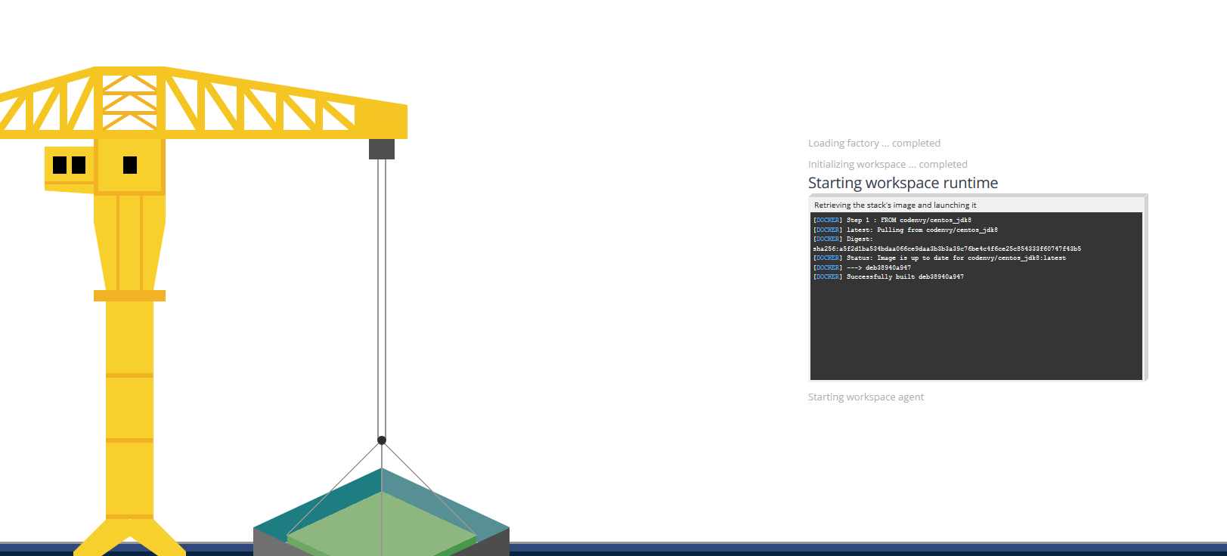
Workspace is creating
When you clicked the link smth interesting has happened. After i configured the project inside Codenvy i created a Factory.
A Factory allowed me to provide you with a link that will create the exact copy of my configured Insights Portal workspace. Workspace is a main concept in Codenvy, in the high level it’s a thing that contains source code, runtime and can contain many different machines required for building/running the product. On the lower level workspace is a running Docker container with some default services required for Codenvy itself (like Apache TomCat) and services specific to the project (like ant/maven for building the code)

Slide 4
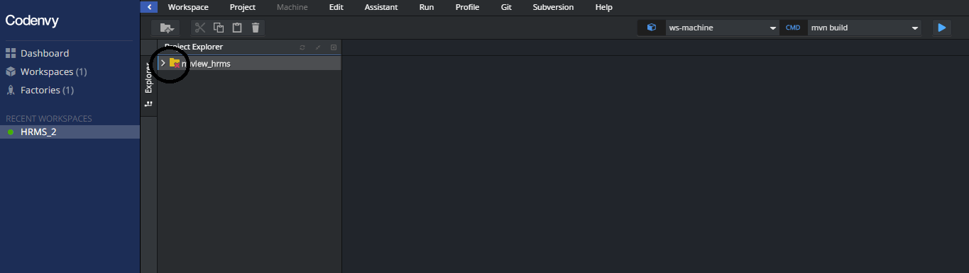
Checking out codebase
The next thing you should do after the workspace is created is to create SSH key-pair and add public key to your BitBucket account.
This red cross icon shows you that the code for project (on the picture the sample project is shown) was not checked out yet. Let’s create a key pair.

Slide 5
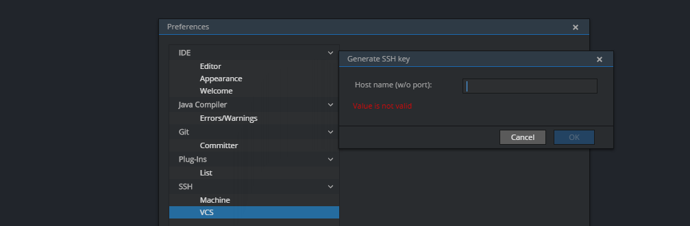

SSH Keys
You need to go to Profile->Preferences->VCS->Generate key
In the hostname type scm.devfactory.com and click OK. You have your key added.
Click on View, copy the key

Slide 6
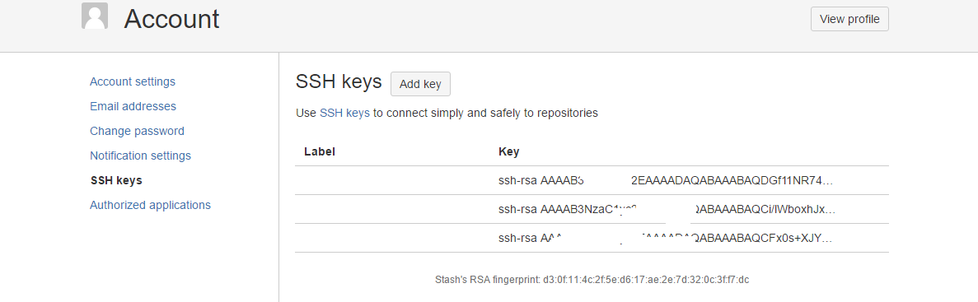
SSH Keys (continue)
Add the key into you Stash account. Please make sure that you have not pasted the key at Bitbucket with the whitespace at the end.

Slide 7
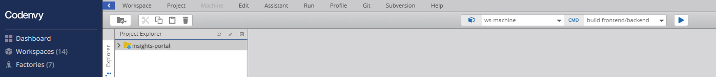
Cloning the code
Then Stop and Start the workspace. The code will be cloned. If it’s not cloned please delete the workspace in the dashboard and follow a link from slide #2 again.
So the workspace can contain project. You can import project from VCS, GitHub, ZIP. OR you can create files yourself.
Every project source files exist in two places: inside Codenvy server and inside workspace (container) (go ahead and do cd /projects to see it).
Workspace can have 2 states: running and stopped.
When you stop the workspace docker container is destroyed, everything you installed inside this container will be lost (if you didn’t create a snapshot for this), BUT everything you did inside your codebase will be safe as the next time you start the workspace Codenvy will inject to this workspace the project code from Codenvy server (Docker volumes make this happen).

Slide 8
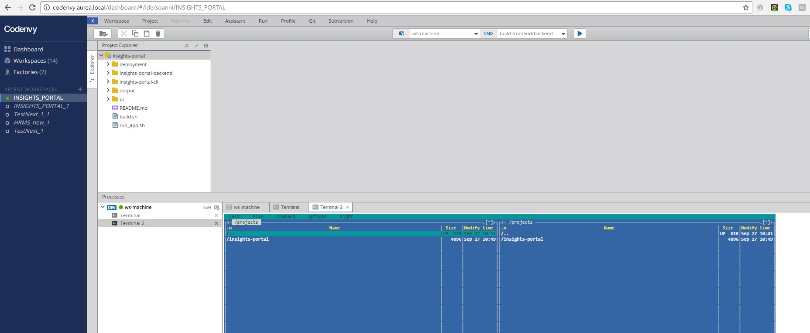
Interface
Okay, code has been checked out. Now we can see Codenvy GUI, We can see one sidebar on the left and the main screen area consisting of project tree, IDE editor, and JavaScript console (cool thing, by the way every prebuilt workspace have Midnight Commander, go ahead and enjoy it running mc)

Slide 9
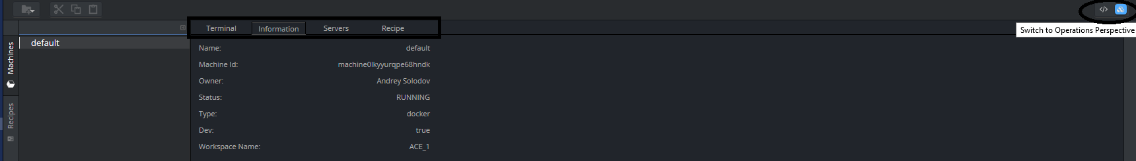
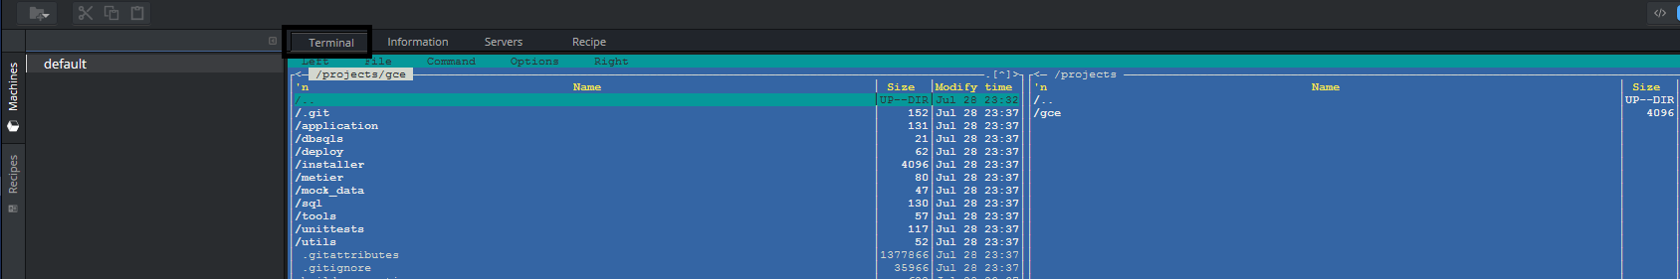
Workspace nuts and bolts...
To see a lot of interesting and IMPORTANT information about a workspace you have to switch to Operations perspective (see the icon on the top right corner). Here we can see 4 tabs: Terminal, Information, Servers, Recipe.
Information tab contains machine name (well, workspace is a machine), ID, etc
Terminal tab is a Java Script terminal to the machine (here I ran mc).

Slide 10
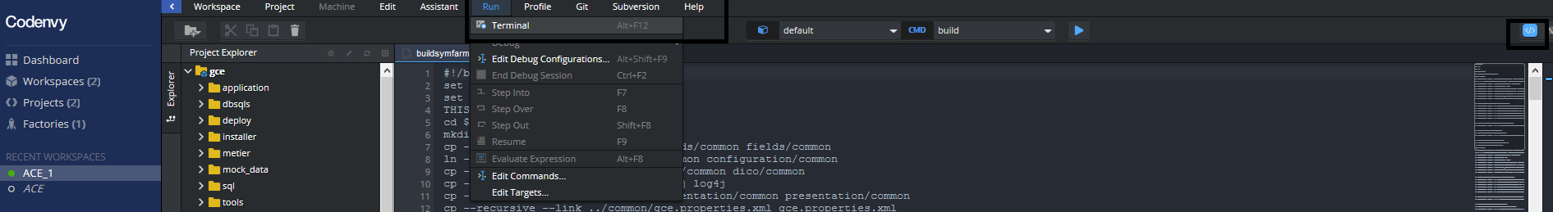
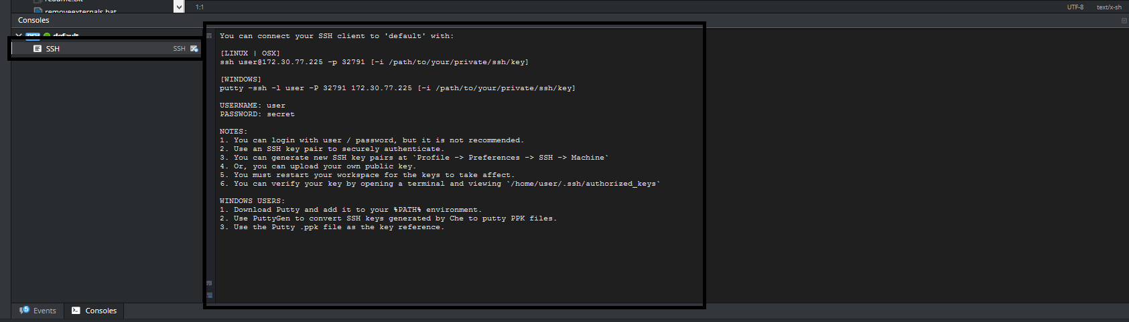
Terminal
Terminal is AWESOME. Let’s talk about it a bit more and i’ll show you some cool things.
Actually if you can’t see a terminal window on you Project Perspective just go to Terminal window and run it.
Or you can SSH to that container. Just press on SSH to see the details.

Slide 11
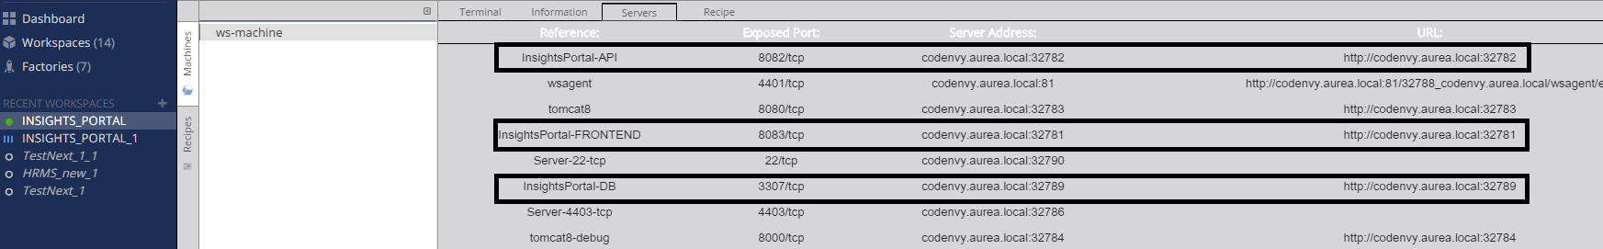
Services. Ports
Let’s switch back to Operations Perspective and investigate very important Servers tab.
Well, every workspace is built from image that as i already mentioned has some preinstalled services that allow to intercommunicate Codenvy server and workspace. These services has exposed ports that are randomly mapping to Codenvy server ports range 32768-65535.
This tab is important and useful tool when you are going to see the result of your build process.
On the screen below you can see the exposed ports for Frontend, API, DB. These ones allow you to see the running app or connect to DB container (of course after you build and run application).

Slide 12
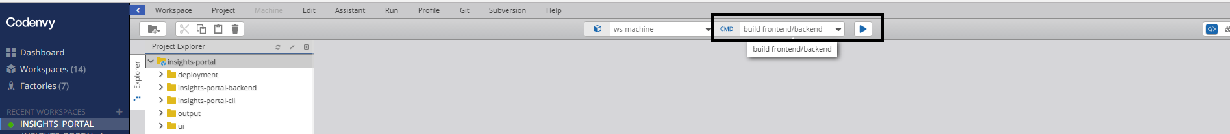
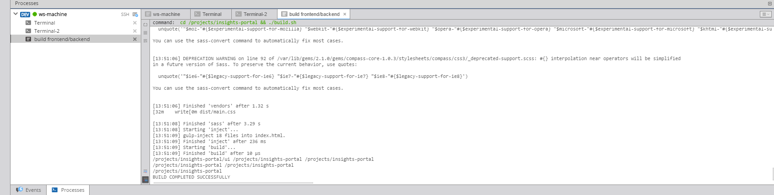
Commands. Build.
In order to make build and run process simple i injected commands in the workspace. Command can be run pressing on the Play button near it. Press build frontend/backend to build the Frontend and Backend parts of the application.
The workspace container already has all dependencies installed: nodejs, npm, ruby, Compass, PhantomJS, bower, grunt, gradle.

Slide 13
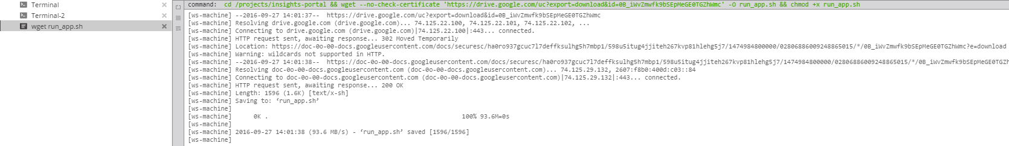
Commands. Application Run.
On this step you need to execute wget run_app.sh command. This command will download a run script which I prepared specifically for that project.
Next, you need to make some modifications to this script and backend Dockerfile. First go to the Servers tab (see slide 11) and copy link to backend. Please REMEMBER that the links will be different every time you stop/start a workspace.

Slide 14
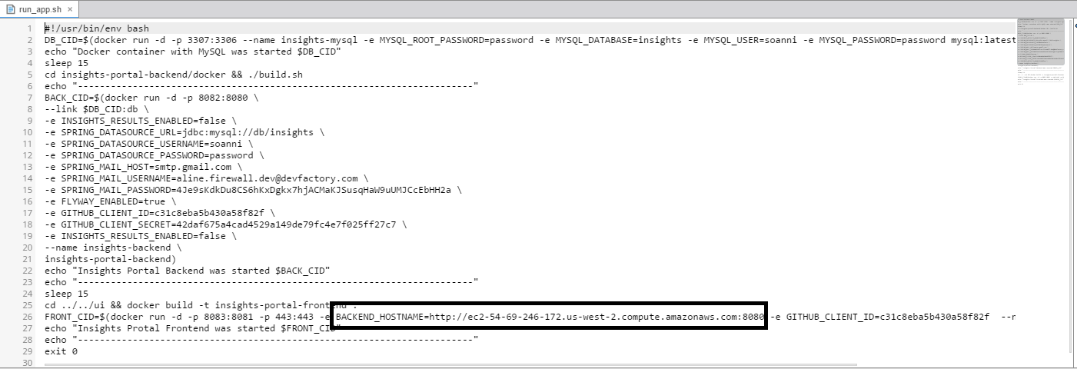
Commands. Application Run.
Now we need to modify run_app.sh script and substitute this:
to this (the address you copied on the previous slide):

Slide 15
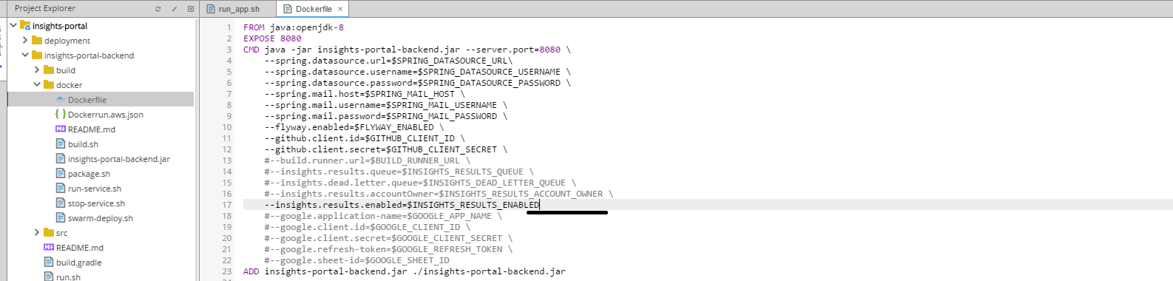
Commands. Application Run.
Now we need to modify backend Dockerfile (as we are not passing some of the variables to docker container in the run_app.sh script). Please take a look you need to delete one backslash:
Next run run Insights Portal command. It will build docker images (API,DB,Frontend) and start containers with services:

Slide 16
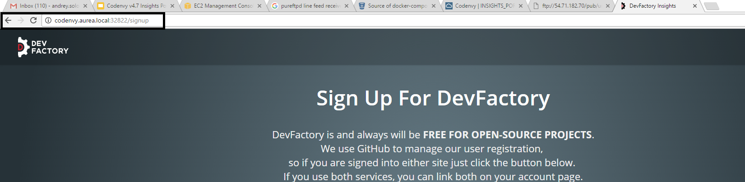
Commands. Application Run. Access Frontend.
Now we can see docker containers with services started:
NOTE: if backend container failed to start try to increase sleep interval from 15 to 30 in run_app.sh script. Then run command docker rm -vf $(docker ps -aq) in the terminal and try to start app again (running run Insights Portal command).
To access frontend look at the Servers tab and follow the link:

Slide 17
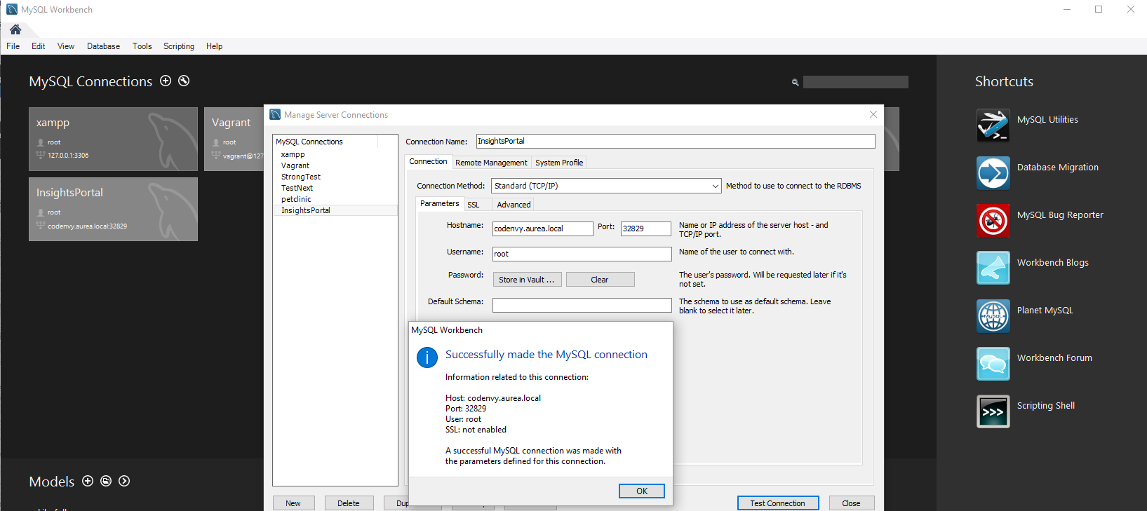
Commands. Application Run. Access DB.

Slide 18
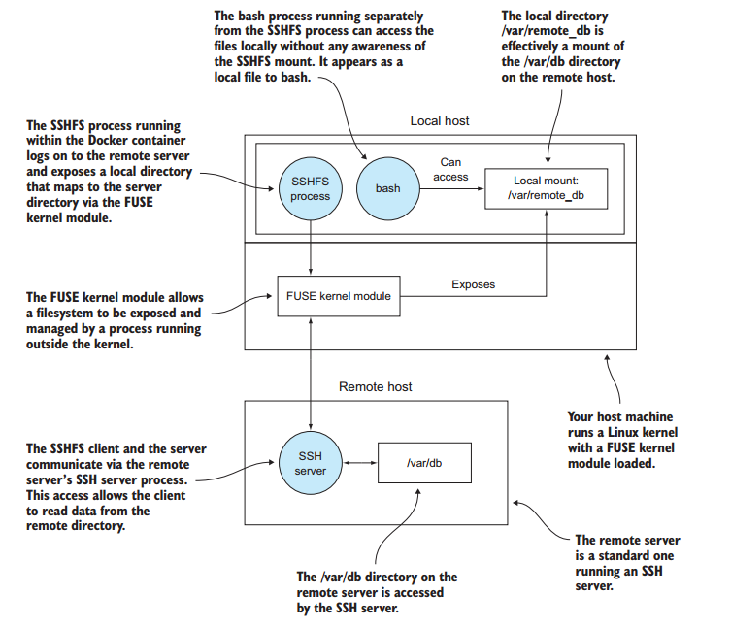
SSH to local IDE
To create SSH connection to your local IDE please follow the link to my presentation:
https://docs.google.com/presentation/d/1rtZb3SymdtbllkonFfkg68YeWdUG5u9FL6h9TGFCxWo/edit?usp=sharing
It’s really simple and working on every platform (Mac, Linux, Windows). It uses sshfs, so be informed that this solution doesn’t clone the contents from Codenvy server. It mounts it. So when you close sshfs connection the local folder where you’ve mounted your sources from Codenvy server will be empty. I showed the mechanics for those interested ================================>

